Slide 1
Learning & Development Enabling development, Impacting growth…
RDV-03
QlikView Training – Day 4

Slide 2
Recap
Introduction to Charts
Data Visualization.qvw
Various Charts
Bar Chart
Line Chart
Combo Chart
Gauge Chart
Tabular Charts
Visual Cues
Mini Chart
Trellis

Slide 3
Session Agenda – Day 4
Charts (contd)
Pie Chart
Block Chart
Grid Chart
Radar Object
Scatter Object

Slide 4
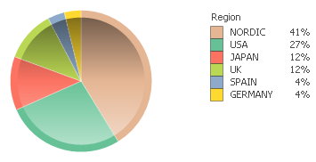
Pie Chart
Visual Distribution of Measurements
Used to Represent Ratios / Total Share
Should not be used when there are too many values

Slide 5
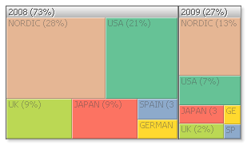
Block Chart
Visual Distribution of Measurements with Multiple Dimensions
Used to Represent Ratios / Total Share

Slide 6
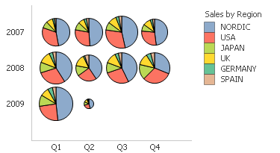
Grid Chart
2 or 3 Dimensions with a Measurement
Used to show Relationships

Slide 7
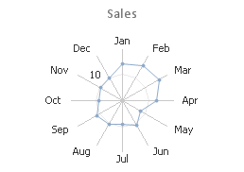
Radar Chart
Comparisons of high-level groups.
Radar charts are a great way to display data by cyclic dimensions including time (24hrs) and seasons (months). They show whether there are any spikes or consistent behaviors around the time frame.

Slide 8
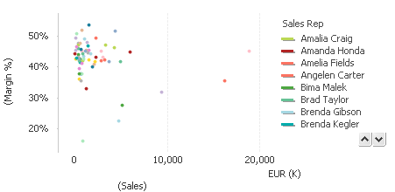
Scatter Chart
Measurements act as dimensions (3D chart)
Used to show Relationships

Slide 9
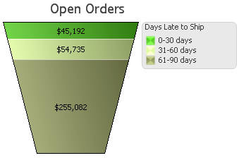
Funnel Chart
Visual Distribution of Measurements
Dimension that contains an expiration timeline

Slide 10
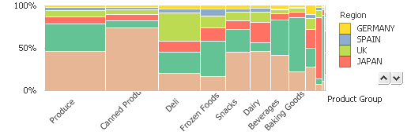
Mekko Chart
Visual Distribution of Measurements with Multiple Dimensions
Similar to Stacked Bar Chart, but has an additional Measure – Width

Slide 11
Q & A
QlikView Training – Day 04

Slide 12
Lab Work
Identify the charts to be used for the following scenarios:
Population Contribution by Each Country
Understanding the Effectiveness of Sales Managers by validating the Sales they've made and the discounts they had offered
Quality Improvement to understand the usage of Vehicles by identification of “Peak Hours” for a Transport System
Population Contribution by Each Country / City
Time taken to respond to Queries in a Call Centre

Slide 13
Best Practices
Gauge Charts & Traffic Light Charts
Used commonly to represent Target / Current State
Tells whether something is wrong / right
No Trend
One Data Point
Real Estate
Relying on Colors, hence Color Blind Users might find it difficult
Alternative for Gauges - Combo Chart
Alternative for Traffic Light - Color Variation + Ranking

Slide 14
Best Practices (contd...)
LED Charts:
Commonly used for Showing Big Numbers
Font Not Legible
Use Text Boxes
Mekko Chart
Commonly used to show 2 dimensions - 1 Height and 1 Width and Measure being stacked
When showing different categorical data, bars stacked on top of each other
No Common baselines - and hence difficult to compare
Alternative for Gauges - Combo Chart

Slide 15
Best Practices (contd...)
Table Charts
Commonly used for showing information in the most detail manner
Hampers the user's ability to quickly interpret and analyze
Understand if it is absolutely required and can replaced with appropriate visualization
Bar Chart
If constants are to be used in stacked bar charts, use them at the bottom
Use Sorting based on Y values, unless Trends are shown
3D Bars will sometime mislead - do not use them unless it is absolutely required
Do not use background images, use gridlines instead
Do not use Value on Text Points, and if require do not plot it inside segments
Usage of Colors - they should not mislead the end user to assume that colors are based on comparison

Slide 16
Best Practices (contd...)
Pie Charts
Research shows that the human eye is not good at differentiating between angles and comparing sector areas
Cannot have multiple data points
Consumes lot of real estate
Series Comparison is not possible with 2 or more pie charts
Do not have too many categories, have others instead
3D pies will be misleading
Scatter Chart
Do not have too many data points will spoil the meaning

Slide 17
Thank You
Review Date | 28-Aug-2015
Version | 1.0
Next Review Due | 28-Aug-2016

